Slide 1

RECONSTRUCTIVE PERIODONTAL SURGERY
RUNGTA COLLEGE OF DENTAL SCIENCES AND RESEARCH,BHILAI
GUIDED TISSUE REGENERATION (GTR)
PRESENTED BY:
Dr Sonika Bodhi
Reader
Dept. of Periodontology

Slide 2
SPECIFIC LEARNING OBJECTIVES
Core areas | Domain | Category
Introduction | Affective | Desire to know
History | Cognitive | Nice to know
Evolution of GTR | Affective | Desire to know
Indications Contraindications | Cognitive | Must to know
Design criteria for GTR devices | Cognitive | Nice to know
Classification of GTR membranes | Cognitive | Must to know
Current trends in membranes | Cognitive | Nice to know

Slide 3
CONTENTS
Introduction
History
Evolution of GTR
Indications
Contraindications
Design criteria for GTR devices
Classification of GTR membranes
Current trends in membranes
Summary
References

Slide 4
INTRODUCTION
Periodontal regeneration is defined histologically as regeneration of the tooth’s supporting tissues, including alveolar bone, periodontal ligament, and cementum over a previously diseased root surface.
(AAP Glossary of Periodontal Terms, 2001)

Slide 5
What is GTR???
The 1996 World Workshop in Periodontics defined GTR as “procedures attempting to regenerate lost periodontal structures through differential tissue responses’’.
The AAP has defined GTR as “the procedure by which a barrier is utilized to exclude epithelium from the root surfaces”.

Slide 6
This method is derived from the classic studies of Nyman(1982), Lindhe(1984), Karring(1986) and Gottlow(1986) and is based on the assumption that only the PDL cells have the potential for regeneration of the attachment apparatus of the tooth.
Notes:
Barriers are employed in the hope of excluding epithelium and connective tissue from the root surface in the belief that they interfere with regeneration.

Slide 7
HISTORY
In 1976 – Melcher described the basic concept that led to development of GTR.
In 1982 – Nyman et al first described the clinical procedure of GTR using a non absorbable barrier…. a cellulose acetate (paper) laboratory filter (Millipore filter).

Slide 8
HISTORY
Gotlow et al. 1986 coined the term Guided Tissue Regeneration.
Other names….
Selective cell repopulation
Controlled tissue regeneration.

Slide 9
BIOLOGIC BASIS OF GTR
Melcher concept (1976)
the type of cell which repopulates the root surface after periodontal surgery determines the nature of the attachment that will form.

Slide 10
After flap surgery the curetted root surface may be repopulated by four different cell types:
Epithelial cells
Cells derived from the gingival connective tissue
Cells derived from the bone
Cells derived from the periodontal ligament.

Slide 11
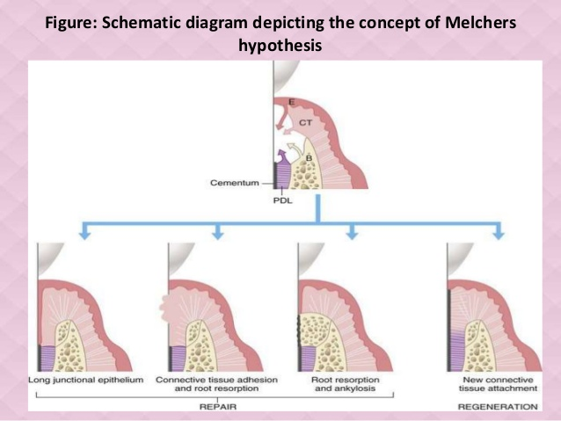

Slide 12
INDICATION
Two or three walled intrabony defects.
Class II furcation defects.
Recession defects.
Circumferential defects
Alveolar ridge augmentation.
Repair of apicoectomy defect.
Osseous fill around immediate implant placement sites.
Repair of osseous defect associated with failing implants.

Slide 13
CONTRAINDICATION
Infection at the site of defect
Poor oral hygiene
Smoking
Tooth Mobility
Horizontal bone loss
Multiple defects
Any medical condition contraindicating surgery

Slide 14
CHARACTERISTICS/DESIGN CRITERIA FOR GTR DEVICES
Greenstein & Caton (1993):
Biocompatibility
Cell occlusiveness
Spacemaking
Tissue integration
clinical manageablilty

Slide 15
GTR MEMBRANES
1st investigated GTR membranes were cellular acetate filter papers.
Extremely unpredictable.
Difficult to manage.
Difficult to cut.
This lead to development of a two-part material:
Open microstructural collar.
Occlusive portion.

Slide 16
Open microstructural collar – could be implanted subgingivally and in grow with connective tissue and limit epithelial migration.
Occlusive portion – would attach to stabilize the wound area, separate cell types for GTR and give strong enough surface to retain sutures snugged around the teeth.

Slide 17
CLASSSIFICATION
Non-resorbable
Resorbable
NATURAL
SYNTHETIC

Slide 18
NON-RESORBABLE MEMBRANES
1st devices approved for clinical use.
Maintain structural integrity.
However, requires a 2nd surgical procedure for removal.

Slide 19
Ethyl Cellulose (Millipore Filter)
Used in the initial studies (Nyman et al 1982, Gottlow 1984, Magnusson et al 1985).
varying amounts of new connective tissue attachment.
Relatively inexpensive.
Brittle.
Difficult to manipulate

Slide 20
PTFE / ePTFE
Polytetrafluoroethylene/Expanded Polytetrafluoroethylene
A fluorocarbon polymer – has exceptional inertness and biocompatibility.
ePTFE or GORE-TEX at present is the only FDA approved non-resorbable material.

Slide 21
Available in various shapes and sizes and usually in 4 preformed sizes :
Single tooth narrow.
Single tooth wide.
Wrap around.
Interproximal.

Slide 22
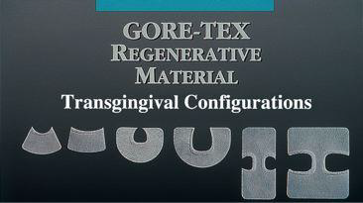

Slide 23
RUBBERDAM
Intimately adapts onto the root surface.
does not have tissue integration potential.
Sensitivity
BIOBRANE
knitted nylon fiber mechanically bonded onto a semipermeable silicone membrane and coated with collagen.

Slide 24
NON-RESORBABLE GTR + BONE GRAFT
Scallhorn & Mclain….
They stated that GTR showed predictability for connective tissue attachment as well as bone formation in infrabony defects and furcations.
Thus, so as to increase bone formation, they used DFDBA + GTR.

Slide 25
Surgical Procedure
Intrasulcular incision for full thickness flap.
Removal of residual pocket epithelium.
Incision should extend 1-2 teeth mesial / distal.
Vertical incisions if necessary.
Degranulation.
Use of optimal root conditioning agent

Slide 26
Adequate trimming of the material to aid in 3mm of lateral and apical extension.
Open microstructure collar is trimmed at the sides only.
9. Flap repositioned 2-3mm coronal to material.
Material removed at 4-8 weeks without disturbing the newly formed granulation tissue.
11. Flap reapproximated and sutured.

Slide 27
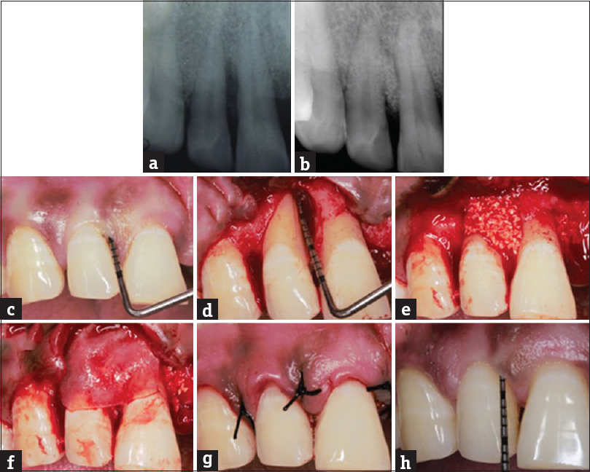

Slide 28
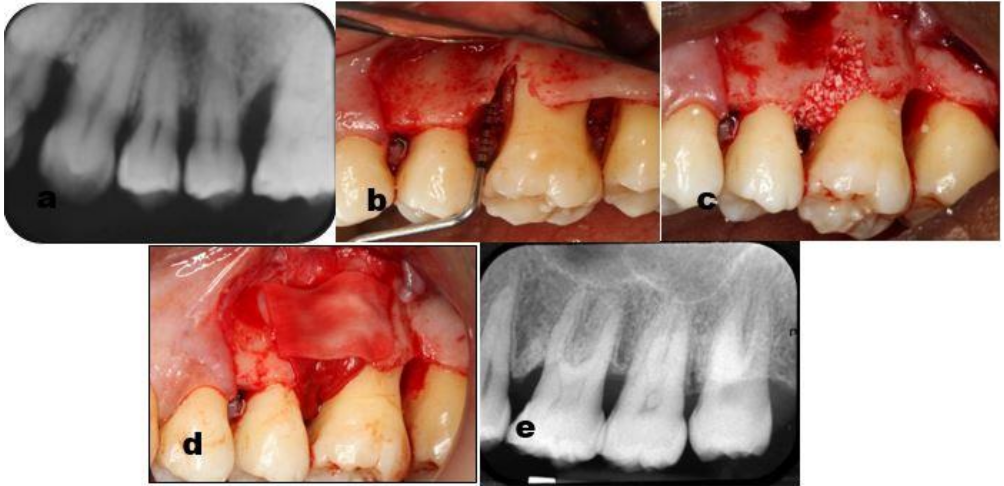

Slide 29
ADVANTAGES
Greater control over the length of time the membrane will remain in place.
If complication arises, removal of a non-resorbable membrane is relatively easy.

Slide 30
DISADVANTAGES
Need for 2nd surgical intervention to retrieve the membrane.
Therefore also higher in cost.
Fixation of membrane may be difficult and time consuming.
GoreTex has a tendency to adhere to root surface during healing thereby preventing PDL cell regeneration.
Gingival recession may cause membrane exposure thus leading to bacterial contamination.

Slide 31
RESORBABLE MEBRANES
Collagen membranes – Periobarrier, Healiguide, Biomend, Paraguide, SX-COL.
Polylactin 910 – Vicryl.
PLA-PGA membranes – Guidor, Atrisorb, Resolut, Epiguide.

Slide 32
COLLAGEN
Cross linked variety of bovine/porcine origin
Resorbs by enzymatic activity of macrophages or PMN’s
Initially in gel/matrix form
1987: Yaffe & Shoshan in experimental dogs, application of collagen on dehiscence prevented epithelial down growth & resulted in regeneration.
Usually type I collagen; animal sources porcine/bovine; tendon/dermis

Slide 33
Isolation & purification: 2 ways
-enzymatic preparation of soluble collagen
-chemical extraction of fibrillar collagen from collagenous tissue
Available as gels, sponges, filaments, membranes etc…
Cross linking either by physical( gamma/UV radiation) & chemical means i.e. Gluteraldehyde

Slide 34
OTHERS:
Duramater
Cargile membranes
Laminar bone

Slide 35
Name | Source | Method of cross-linking | Components | Resoption Rate
Biomend | Bovine tendon | Formaldehyde | Type I Collagen | 6 – 8 weeks.
Biomend - Extend | Bovine tendon | Formaldehyde | Type I Collagen | 18 weeks.
Periogen | Bovine dermis | Gluteraldehyde | Type I & III Collagen | 4 – 8 weeks.
Paroguide | Calf skin | Diphenylphosphoryl azide (DPPA) | 96% type I collagen. 4% chondroitin 4% sulphate. | 4 – 8 weeks.
BioGide | Porcine dermis |  | Type I & III Collagen | 24 weeks.
Tissue guide | Bovine dermis + tendon | Hexamethylene diisocyanate (HMDIC) | Atelocollagen + tendon collagen | 4 – 8 weeks.
Biobar | Bovine tendon |  | Type I Collagen | 6 – 8 months

Slide 36
Synthetic grafts
Polylactic & Polyglycolic acid
Degradable polymers
Degrade by hydrolysis of the ester bonds
Requires 30-60 plus days depending on composition

Slide 37
Atrisorb:
polymer of lactic acid, poly( D,L lactide) dissolved in N-methyl-2-pyrolidone ( NMP)
prepared as a solution which coagulates/sets to firm consistency on contact with water or aqueous solution
Can be used as a chair side kit

Slide 38
Current trends in membranes
Membranes combined with growth factors like PDGF and BMPs
Combined use with Enamel Derived Proteins (EMDOGAIN)........ mainly amelogenin, are secreted by Hertwig’s epithelial root sheath during tooth development and induce acellular cementum formation.

Slide 39
These biologic mediators have been used:
to stimulate periodontal wound healing (e.g., promoting migration and proliferation of fibroblasts for periodontal ligament formation)
to promote the differentiation of cells to become osteoblasts, thereby favoring bone formation

Slide 40
Summary
The use of GTR membranes can lead to significant periodontal regeneration with formation of alveolar bone, cementum and inserting periodontal ligament fibers, although complete regeneration has never been reported.

Slide 41
REFERENCES
Newman MG, Takei HH, Klokkevold PR, Carranza FA. Carranza’s clinical periodontology, 10th ed. Saunders Elsevier; 2007.
Lindhe J, Lang NP and Karring T. Clinical Periodontology and Implant Dentistry. 6th ed. Oxford (UK): Blackwell Publishing Ltd.; 2015.
Newman MG, Takei HH, Klokkevold PR, Carranza FA. Carranza’s clinical periodontology, 13th ed. Saunders Elsevier; 2018.

